Slide 1
Working with locations & maps
Medhat Elmasry

Slide 2
Objectives
Applied
Configure the Google Maps Android API v2 so it works on your system.
Define the permissions and features necessary for an Android app that uses version 2 of the Google Maps Android API.
Use Google Play services to get and track the current location.
Use Location services to make sure GPS is enabled.
Display a Google Map, control its appearance, and zoom in on a location.
Add markers and lines to a Google Map.

Slide 3
Objectives
Knowledge
List three ways that an Android app can get location updates and describe some of the pros and cons of each.
List the three components of Google Maps for Android.
List at least two mapping systems that include an Android I and describe the pros and cons of each.
List and describe some of the features of the Google Maps Android API starting with geocoding and routing.
Describe some of the differences between versions 1 and 2 of the Google Maps Android API.
List and describe the four types of Google Maps.

Slide 4
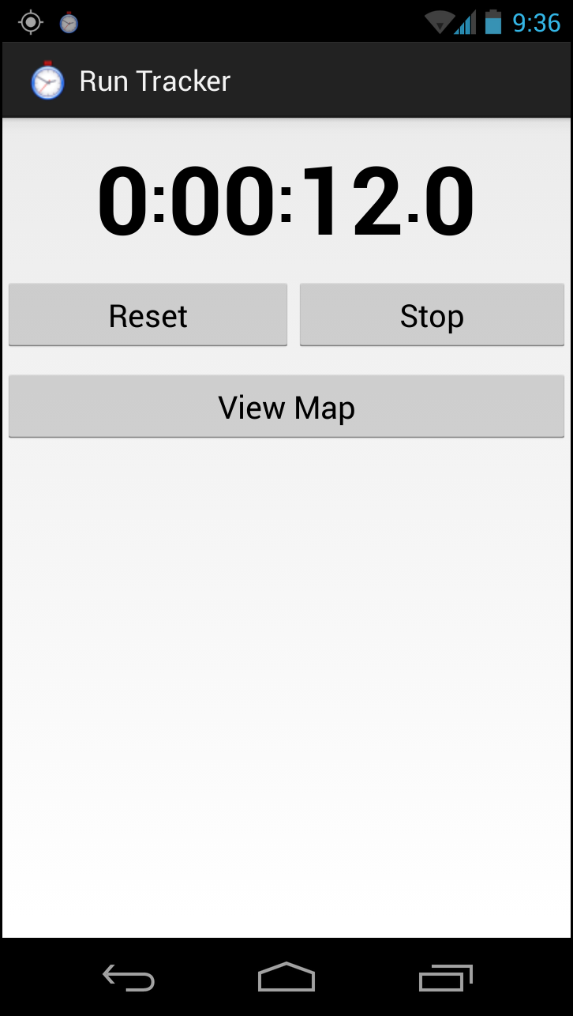
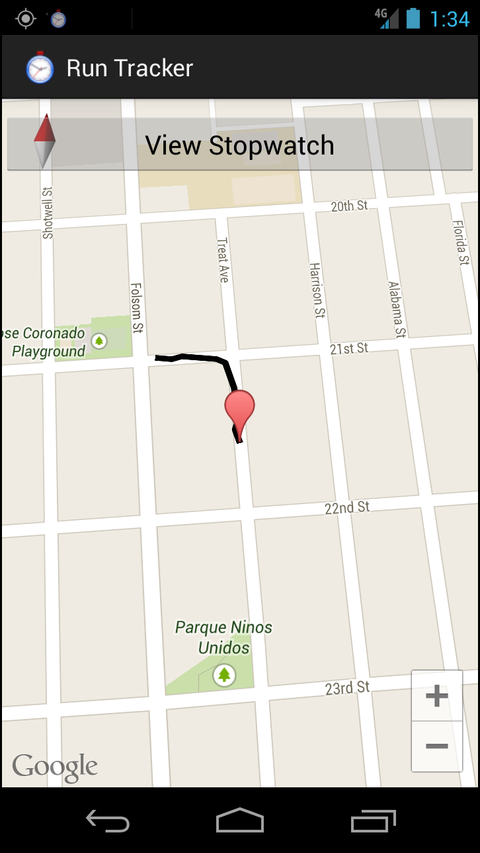
The stopwatch activity
The Run Map activity

Slide 5
GPS (Global Positioning System satellites)
Pros
Most accurate
Cons
Only works outdoors, not indoors
Consumes more battery power
Returns the location slowly
Network
Pros
Works outdoors and indoors
Consumes less battery power
Returns the location more quickly
Cons
Less accurate

Slide 6
Passive (listens to updates for other apps)
Pros
Doesn’t use any extra battery power
Cons
Doesn’t let you control when your app gets updates

Slide 7
Google Maps
Website
https://developers.google.com/maps/
Description
Includes (1) the Android API, (2) the base maps, and (3) the servers to serve map tiles
Pros
Popular and familiar
Free for most users
Many features:
Cons
Not free for the heaviest users
Lack of control
Geocoding | Routing | Street view
Traffic | 3D Buildings

Slide 8
MapQuest
Web site
http://developer.mapquest.com/
Description
MapQuest works much like Google Maps, but it has recently embraced open-source mapping.
Pros
Open version is free for all users
Cons
Not as many features

Slide 9
Google Maps Android API - Version 1 (v1)
Has been officially deprecated as of December 3rd, 2012.
Requests for API keys are no longer accepted as of March 18th, 2013.
New features are no longer being added.
Continues to work for existing apps.
Uses the MapActivity class to encapsulate maps. This doesn’t provide much flexibility for displaying maps on both small and large screens.
Allows several types of overlays on the map.
Is not part of the standard Android library.
Is a part of the Google APIs add-on.

Slide 10
Google Maps Android API - Version 2 (v2)
Is encouraged for all new app development.
Is distributed as part of the Google Play services SDK.
Uses the MapFragment class to encapsulate maps. This allows you more flexibility for displaying maps on both small and large screens.
Uses vector tiles. This allows maps to display faster and use less bandwidth.
Uses improved caching. This typically allows the map to display without showing empty areas.
Supports 3D. This allows you to show the map with perspective by moving the user’s viewpoint.

Slide 11
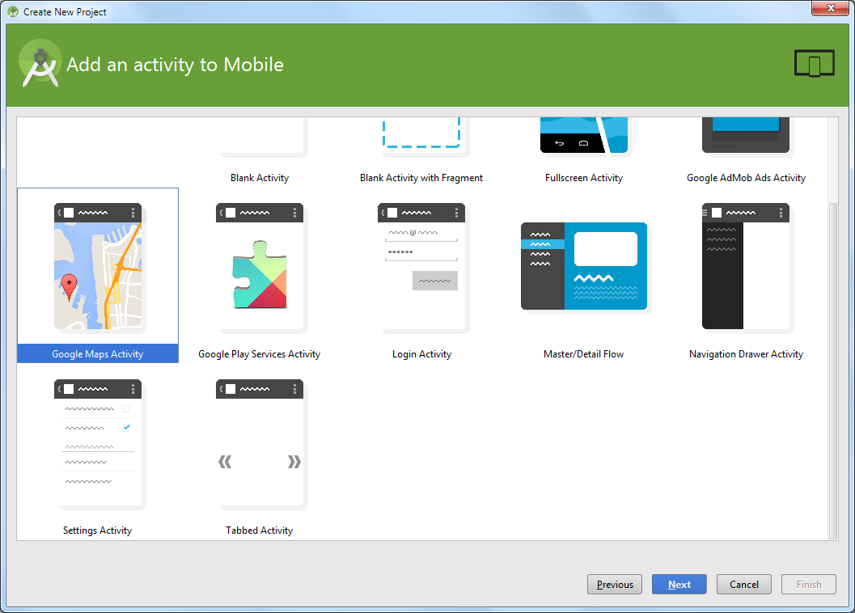
How to create a new Google Maps project?

Slide 12
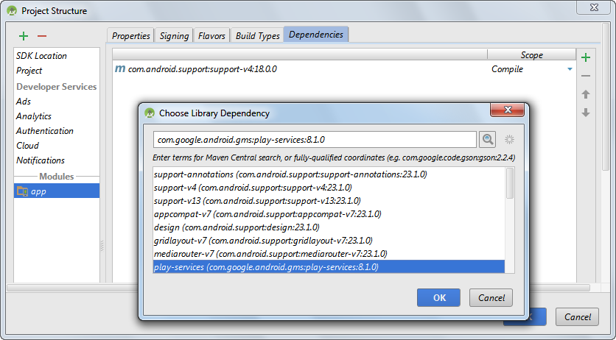
How to add Google Play services to an existing project?

Slide 13
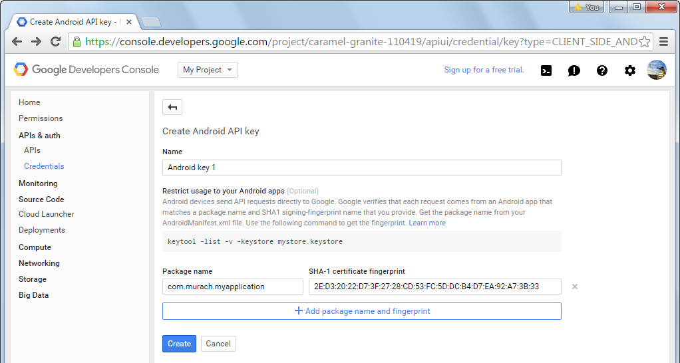
Web page for creating an API key

Slide 14
Part of AndroidManifest.xml file for Run Tracker app
...
<!-- set up MAPS_RECEIVE permission -->
<permission
android:name="com.murach.runtracker.permission.MAPS_RECEIVE"
android:protectionLevel="signature" />
<uses-permission android:name="com.murach.runtracker.permission.MAPS_RECEIVE" />
<!-- set other permissions -->
<uses-permission android:name="android.permission.INTERNET" />
<uses-permission android:name="android.permission.ACCESS_NETWORK_STATE" />
<uses-permission android:name="android.permission.WRITE_EXTERNAL_STORAGE" />
<uses-permission android:name="com.google.android.providers.gsf.permission.READ_GSERVICES" />
<uses-permission android:name="android.permission.AC

Slide 15
Part of AndroidManifest.xml file for Run Tracker app (Continued …)
<!-- Maps API version 2 requires OpenGL ES version 2 -->
<uses-feature android:glEsVersion="0x00020000" android:required="true" />
<application
android:allowBackup="true"
android:icon="@drawable/ic_launcher"
android:label="@string/app_name"
android:theme="@style/AppTheme" >
<meta-data
android:name="com.google.android.maps.v2.API_KEY"
android:value="@string/google_maps_key" />
...

Slide 16
Attributes of the meta-data element
name
value
Attributes of the permission element
name
protectionLevel
A summary of permissions
MAPS_RECEIVE
INTERNET
ACCESS_NETWORK_STATE
WRITE_EXTERNAL_STORAGE
READ_GSERVICES
ACCESS_FINE_LOCATION
ACCESS_COARSE_LOCATION
Attributes of the uses-feature element
glEsVersion
required

Slide 17
The LocationViewerActivity class
package com.murach.locationviewer;
import android.location.Location;
import android.app.Activity;
import android.os.Bundle;
import android.widget.TextView;
import com.google.android.gms.common.ConnectionResult;
import com.google.android.gms.common.api.GoogleApiClient;
import com.google.android.gms.common.api.GoogleApiClient.ConnectionCallbacks;
import com.google.android.gms.common.api.GoogleApiClient.OnConnectionFailedListener;

Slide 18
The LocationViewerActivity class (continued)
public class LocationViewerActivity extends Activity implements ConnectionCallbacks, OnConnectionFailedListener {
private GoogleApiClient googleApiClient;
private TextView coordinatesTextView;
@Override
protected void onCreate(Bundle savedInstanceState) {
super.onCreate(savedInstanceState);
setContentView(R.layout.activity_location_viewer);
coordinatesTextView = (TextView)findViewById(R.id.cooridinatesTextView);
googleApiClient = new GoogleApiClient.Builder(this)
.addApi(LocationServices.API)
.addConnectionCallbacks(this)
.addOnConnectionFailedListener(this)
.build();
}

Slide 19
Constructors and methods of the GoogleApiClient.Builder class
Builder(ctx)
addApi(api)
addConnectionCallbacks(ctx)
addOnConnectionFailedListener(ctx)
build()

Slide 20
The LocationViewerActivity class (continued)
@Override
public void onStart() {
super.onStart();
googleApiClient.connect();
}
@Override
public void onStop() {
googleApiClient.disconnect();
super.onStop();
}
More methods of the GoogleApiClient class
connect()
disconnect()

Slide 21
The LocationViewerActivity class (continued)
//**********************************************************
// Implement ConnectionCallbacks interface
//**********************************************************
@Override
public void onConnected(Bundle dataBundle) {
// Put code to run after connecting here
}
@Override
public void onConnectionSuspended() {
// Put code to run before disconnecting here
}
Methods of the ConnectionCallbacks interface
onConnected(dataBundle)
onConnectionSuspended()

Slide 22
The LocationViewerActivity class (continued)
//*********************************************************
// Implement OnConnectionFailedListener
//*********************************************************
@Override
public void onConnectionFailed(ConnectionResult result) {
// Put code to run if connection fails here
}
}
A method of the OnConnectionFailedListener interface
onConnectionFailed()

Slide 23
Code that gets the current location
@Override
public void onConnected(Bundle bundle) {
Location location = LocationServices.FusedLocationApi.getLastLocation(googleApiClient);
if (location != null) {
coordinatesTextView.setText(location.getLatitude() + "|" + location.getLongitude());
}
}
A method of the LocationServices.FusedLocationApi field
onConnectionFailed()

Slide 24
Four methods of the Location class
getLatitude()
getLongitude()
getTime()
getAccuracy()

Slide 25
Code that handles a failed connection
The constant for the request code
private final static int CONNECTION_FAILURE_RESOLUTION_REQUEST = 9000;
The onConnectionFailed method
@Override
public void onConnectionFailed(ConnectionResult connectionResult) {
if (connectionResult.hasResolution()) {
try {
connectionResult.startResolutionForResult(this, CONNECTION_FAILURE_RESOLUTION_REQUEST);
} catch (IntentSender.SendIntentException e) {
e.printStackTrace();
}
} else {
new AlertDialog.Builder(this)
.setMessage("Connection failed. Error code: " + connectionResult.getErrorCode())
.show();
}
}

Slide 26
Code that handles a failed connection (continued)
The onActivityResult method
@Override
protected void onActivityResult(int requestCode, int resultCode, Intent data) {
super.onActivityResult(requestCode, resultCode, data);
if (requestCode == CONNECTION_FAILURE_RESOLUTION_REQUEST) {
// perform additional processing here
}
}
Methods of the ConnectionResult class
hasResolution()
startResolutionForResult(activity, code)
getErrorCode()

Slide 27
How to get location updates?
Step 1: Import the classes for working with locations
import com.google.android.gms.location.LocationListener;
import com.google.android.gms.location.LocationRequest;
import com.google.android.gms.location.LocationServices;
Step 2: Declare the LocationListener interface
public class LocationViewerActivity extends Activity
implements ConnectionCallbacks, OnConnectionFailedListener, LocationListener {
Step 3: Declare the constants and instance variables
public static final int UPDATE_INTERVAL = 5000; // 5 secs
public static final int FASTEST_UPDATE_INTERVAL = 2000; // 2 secs
private LocationRequest locationRequest;
Step 4: Create the request in onCreate
locationRequest = LocationRequest.create()
.setPriority(LocationRequest.PRIORITY_HIGH_ACCURACY)
.setInterval(UPDATE_INTERVAL)
.setFastestInterval(FASTEST_UPDATE_INTERVAL);

Slide 28
How to get location updates? (continued)
Step 5: Request updates in onConnected
LocationServices.FusedLocationApi.requestLocationUpdates(googleApiClient, locationRequest, this);
Step 6: Remove updates in onConnectionSuspended
if (googleApiClient.isConnected()) {
LocationServices.FusedLocationApi.removeLocationUpdates(googleApiClient, this);
}
Step 7: Implement the LocationListener interface
@Override
public void onLocationChanged(Location location) {
coordinatesTextView.setText(location.getLatitude() + "|" + location.getLongitude());
}

Slide 29
Methods of the LocationRequest class
create()
setPriority(accuracy)
setInterval(millis)
setFastestInterval(millis)
Constants from the LocationRequest class
PRIORITY_HIGH_ACCURACY
PRIORITY_BALANCED_POWER_ACCURACY
PRIORITY_NO_POWER
Methods of the LocationServices.FusedLocationApi field
requestLocationUpdates(client, request, listener)
removeLocationUpdates(client, listener)

Slide 30
Code that makes sure GPS is enabled
LocationManager locationManager =
(LocationManager) getSystemService(LOCATION_SERVICE);
if (!locationManager.isProviderEnabled(
LocationManager.GPS_PROVIDER)){
Toast.makeText(this, "Please enable GPS!",
Toast.LENGTH_LONG).show();
Intent intent = new Intent(
Settings.ACTION_LOCATION_SOURCE_SETTINGS);
startActivity(intent);
}
Method of the Activity class
getSystemService(serviceType)
Constants/method of the LocationManager class
GPS_PROVIDER
NETWORK_PROVIDER
isProviderEnabled(providerType)

Slide 31
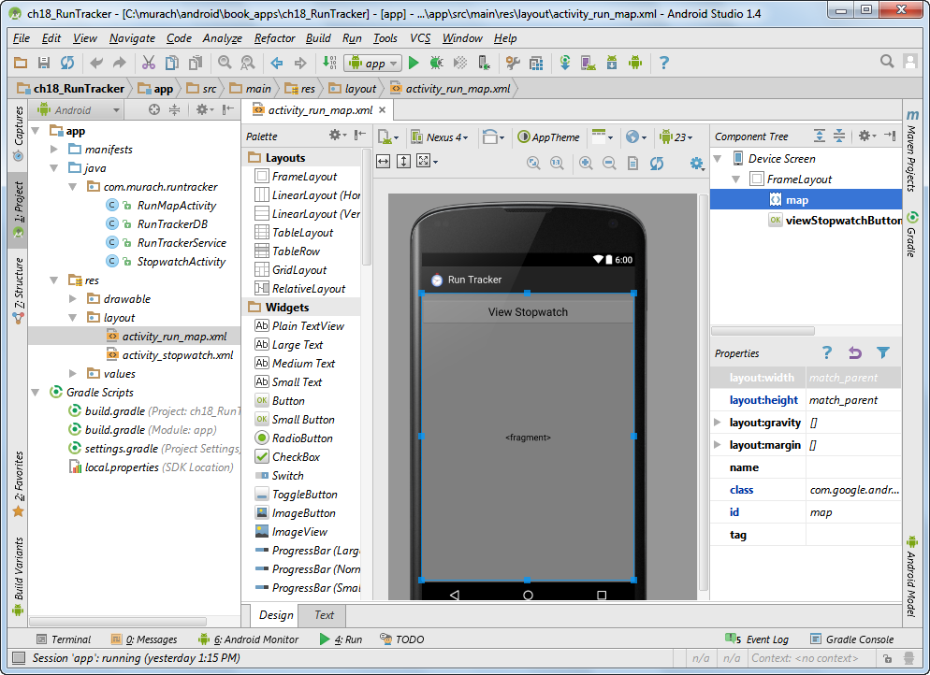
A layout that includes a map fragment

Slide 32
The XML for a map fragment
<fragment
android:id="@+id/map"
android:layout_width="match_parent"
android:layout_height="match_parent"
class="com.google.android.gms.maps.SupportMapFragment" />

Slide 33
How to display a map
Step 1: Extend the FragmentActivity class
public class LocationViewerActivity extends FragmentActivity
implements ConnectionCallbacks, OnConnectionFailedListener, LocationListener {
Step 2: Declare the GoogleMap instance variable
private GoogleMap map;
Step 3: Get the GoogleMap object in the onStart method
// if GoogleMap object is not already available, get it
if (map == null) {
FragmentManager manager = getSupportFragmentManager();
SupportMapFragment fragment = (SupportMapFragment) manager.findFragmentById(R.id.map);
map = fragment.getMap();
}
// if GoogleMap object is available, configure it
if (map != null) {
map.getUiSettings().setZoomControlsEnabled(true);
}

Slide 34
A method of the SupportMapFragment class
getMap()
Some constants of the GoogleMap class
MAP_TYPE_NORMAL
MAP_TYPE_HYBRID
MAP_TYPE_SATELLITE
MAP_TYPE_TERRAIN
Some methods of the GoogleMap class
setMapType(mapType)
getUiSettings()
Some methods of the UiSettings class
setCompassEnabled(bool)
setZoomControlsEnabled(bool)
setZoomGesturesEnabled(bool)

Slide 35
How to zoom in on a map
if (map != null) {
map.animateCamera(
CameraUpdateFactory.newCameraPosition(
new CameraPosition.Builder()
.target(new LatLng(location.getLatitude(), location.getLongitude()))
.zoom(16.5f)
.bearing(0)
.tilt(25)
.build()));
}

Slide 36
More methods of the GoogleMap class
animateCamera(cameraPosition)
moveCamera(cameraPosition)
getMaxZoomLevel()
Some methods of the CameraPosition.Builder class
target(latLng)
zoom(level)
bearing(degrees)
tilt(degrees)
build()
Constructor of the LatLng class
LatLng(latitude, longitude)

Slide 37
How to add a marker for the current location
if (map != null) {
map.clear(); // clear any old markers
map.addMarker(
new MarkerOptions()
.position(new LatLng(location.getLatitude(),
location.getLongitude()))
.title("You are here"));
}
How to set a new icon for a marker
.icon(BitmapDescriptorFactory.fromResource(R.drawable.ic_runner))

Slide 38
More methods of the GoogleMap class
clear()
addMarker(marker)
Some methods of the MarkerOptions class
position(latLng)
title(title)
icon(bitmapDescriptor)

Slide 39
How to add lines to a map
if (map != null) {
PolylineOptions polyline = new PolylineOptions();
if (locationList.size() > 0) {
for (Location l : locationList) {
LatLng point = new LatLng(
l.getLatitude(), l.getLongitude());
polyline.add(point);
}
}
map.addPolyline(polyline);
}
An example that sets the width of a line
polyline.width(10);
An example that sets the color of a line
polyline.color(Color.RED);

Slide 40
More methods of the GoogleMap class
addPolyline(polyline)
Constructor of the PolylineOptions class
PolylineOptions()
Methods of the PolylineOptions class
add(latLng)
width(pixels)
color(argbColor)

Slide 41
The activity_run_map layout
<?xml version="1.0" encoding="utf-8"?>
<FrameLayout xmlns:android="http://schemas.android.com/apk/res/android"
android:layout_width="match_parent" android:layout_height="match_parent" >
<fragment
android:id="@+id/map"
android:layout_width="match_parent"
android:layout_height="match_parent"
class="com.google.android.gms.maps.SupportMapFragment" />
<Button
android:id="@+id/viewStopwatchButton"
android:layout_width="match_parent"
android:layout_height="wrap_content"
android:layout_marginTop="10dp"
android:gravity="center"
android:text="@string/stopwatch"
android:textSize="20sp" />
</FrameLayout>

